Slide 1
CS35L-5
Week 1 - Day1

Slide 2
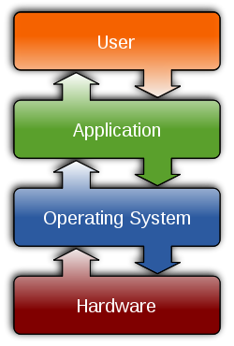
Operating System
Interface between application and hardware
Process Management
Memory Management
File Systems
Hardware Drivers
Networking
Security
http://en.wikipedia.org/wiki/Operating_system
Notes:
Operating System is a piece of software acting as the interface between application and hardware. It manage hardware devices using interrupts and drivers, manage storage resources using memory management technique and building a file system to store files on harddisks. It also manage all the applications running on it using process management and security options. Last but not least, it provides the basic interface of networking with other devices.

Slide 3
GNU/Linux
Open-source operating system
Kernel: core of operating system
Allocates time and memory to programs
Handles file system and communication between software and hardware
Shell: interface between user and kernel
Interprets commands user types in
Takes necessary action to cause commands to be carried out
Programs

Slide 4
Why Linux?
Cost
Free
Free applications
Quality
Stability
Reliability
Open Source
Good community, heavily documented
Widely used among researchers and developers
Customizable at OS level

Slide 5
Files and Processes
Everything is a file (or process):
File: collection of data
A document
Text of program written in high-level language
Executable
Directory
Devices
Process: an executing program identified by PID

Slide 6
Unix File System Layout
Tree structured hierarchy
/
root
bin
dev
home
usr
tmp
lakers
celtics
bulls
lib
README
music
doc
game1
game2
Notes:
Each file is under a directory.
A directory is also a file.
Only one root “/”.
Regular files can only be leaves.
e.g., documents, music, etc.

Slide 7
Absolute Path vs. Relative Path
/
root
bin
dev
home
usr
tmp
lakers
celtics
bulls
lib
README
music
doc
game1
game2
Current directory: home

Slide 8
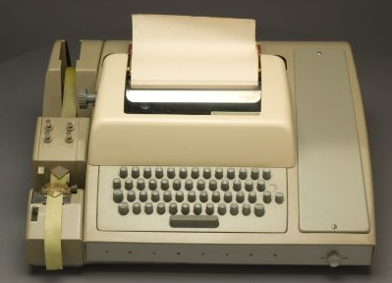
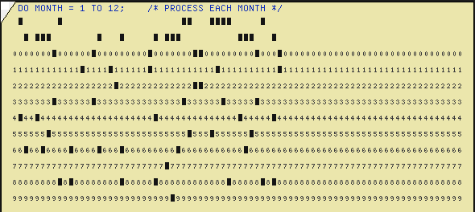
Interacting with Computers - History
Switches and Lights
Batch Processing
Teletype - CLI
GUI

Slide 9
User Interfaces: CLI vs GUI
CLI - Command Line Interface
Steep learning curve
More control
Cumbersome multitasking
Speed with commands
Low resources
Power of scripting
GUI - Graphic User Interface
Intuitive to use
Limited by interface
Easy multitasking
Limited by pointing
Graphic eats resources
Difficult to automate

Slide 10
The Basics: Shell
<up arrow>: previous command
<tab>: auto-complete
!!: replace with previous command
![str]: refer to previous command with str
Format: command -options arguments
eg. ls -l prefix*

Slide 11
The Basics: Moving Around
pwd: print working directory
cd: change directory
~ home directory
. current directory
/ root directory, or directory separator
.. parent directory

Slide 12
The Basics: Dealing with Files
mv: move/rename a file
cp: copy a file
rm: remove a file
r: remove directories and their contents recursively
mkdir: make a directory
rmdir: remove an empty directory
ls: list contents of a directory. Various useful options.
cat: concatenates contents of file
head: displays first n lines of file
tail: displays last n lines of file

Slide 13
The Basics: Changing File Attributes
touch: update access & modification time to current time
touch filename
touch -t 201101311759.30 filename
Change filename’s access & modification time to (year 2011 January day 31 time 17:59:30)

Slide 14
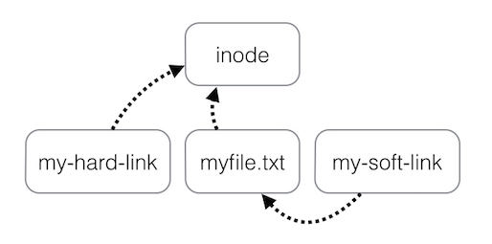
ln
ln: create a link
Hard links: point to physical data
Soft links aka symbolic links (-s): point to a file

Slide 15
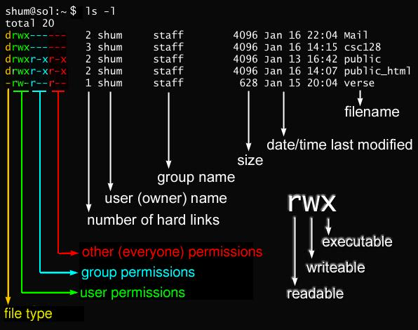
Linux File Permissions

Slide 16
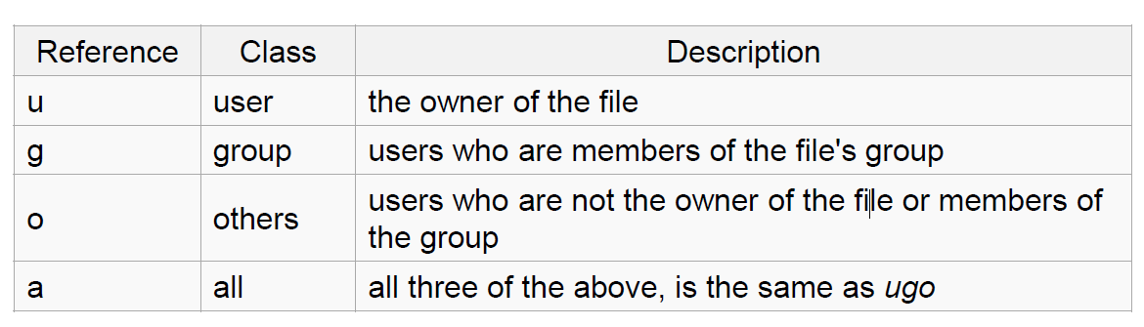
Linux File Permissions
chmod
read (r), write (w), executable (x)
User, group, others

Slide 17
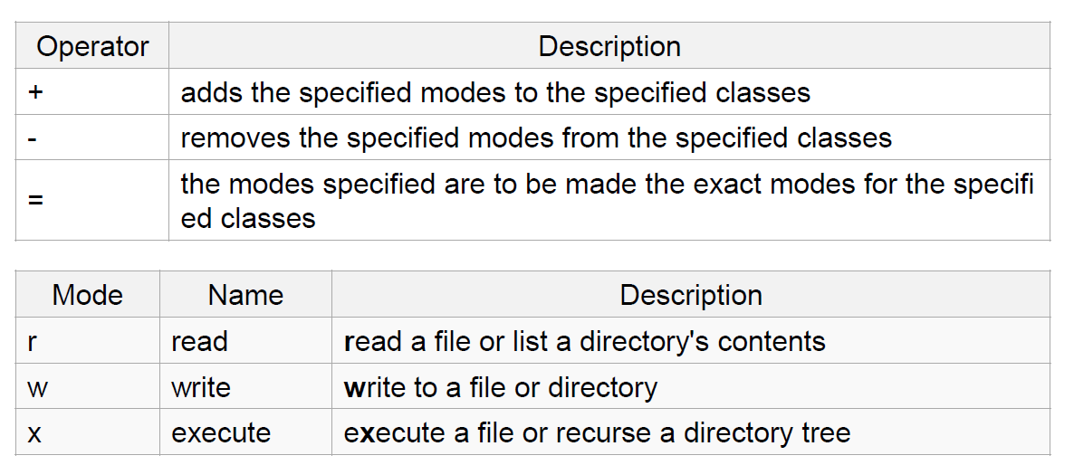
The Basics: chmod (symbolic)

Slide 18
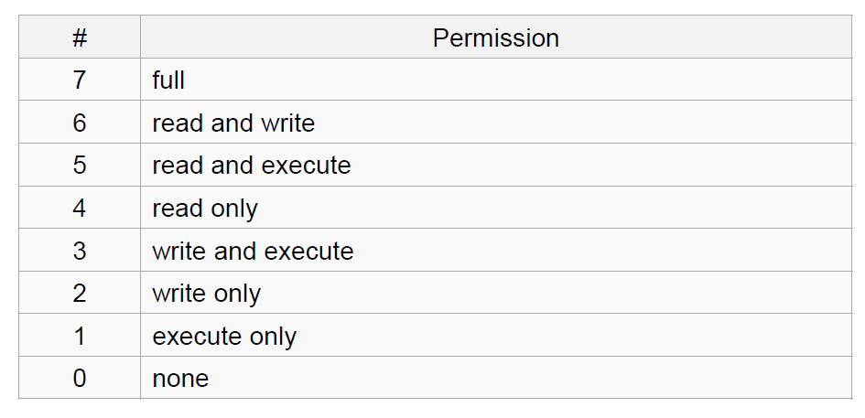
The Basics: chmod (numeric)
Usage
– chmod [''references''][''operator''][''modes''] ''file1'' ...
Example: chmod ug+rw mydir, chmod a-w myfile,
Example: chmod ug=rx mydir, chmod 664 myfile

Slide 19
The Basics: find
-type: type of a file (e.g: directory, symbolic link)
-perm: permission of a file
-name: name of a file
-user: owner of a file
-maxdepth: how many levels to search
Examples
find . -name my*
find . -name my* -type f
find / -type f -name myfile -print

Slide 20
File Name Matching
?: matches any single character in a filename
*: matches one or more characters in a filename
[]: matches any one of the characters between the brackets. Use ‘-’ to separate a range of consecutive characters.
ls -l [a-zA-Z]*

Slide 21
Lost? man
Extensive documentation that comes preinstalled with almost all substantial Unix and Unix-like operating systems
Usage
read a manual page for a Linux command
man <command_name>
Hit “q” to get out of man page

Slide 22
More Linux Commands
Pipeline
Redirect the output of the first tool to the input of the following one.
Often useful with | grep
man grep | grep pattern
Redirection
> : write stdout to a file (creates if not present else overwrites)
>>: append stdout to a file (creates if not present)
< : use contents of a file as stdin

Slide 23
wh… Commands
whatis <command>: returns Name section of man page
whereis <command>: locates the binary, source, and manual page files for a command
who, whoami,which

Slide 24
More commands: Manage Processes
ps: report a snapshot of current processes
top: dynamic view of linux tasks
kill: send a terminate signal to a process
Notes:
top: monitoring processes
ps: write information about processes, subject to having appropriate privileges to obtain information about those processes.

